Slide 1
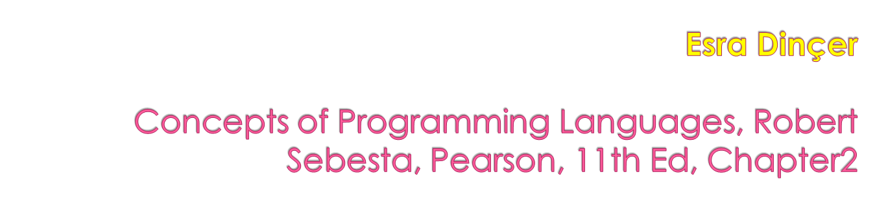
Evolution of the Major Programming Languages
1-<number>

Slide 2

To introduce the evolution and the development of the major programing languages
The contributions of the language
The motivation for its development
1-<number>

Slide 3

Development, development environment, and evaluation of a number of important programming languages
Perspective into current issues in language design
1-<number>

Slide 4

The IBM 704 and Fortran
Functional Programming: LISP
The First Step Toward Sophistication: ALGOL 60
Computerizing Business Records: COBOL
The Beginnings of Timesharing: BASIC
1-<number>

Slide 5

Everything for Everybody: PL/I
Two Early Dynamic Languages: APL and SNOBOL
The Beginnings of Data Abstraction: SIMULA 67
Orthogonal Design: ALGOL 68
Some Early Descendants of the ALGOLs
Programming Based on Logic: Prolog
History's Largest Design Effort: Ada
1-<number>

Slide 6

Object-Oriented Programming: Smalltalk
Combining Imperative ad Object-Oriented Features: C++
An Imperative-Based Object-Oriented Language: Java
Scripting Languages
The Flagship .NET Language: C#
Markup/Programming Hybrid Languages
1-<number>

Slide 7

Knowing the past,
helps us
to understand today
and guess the future
1-<number>

Slide 8

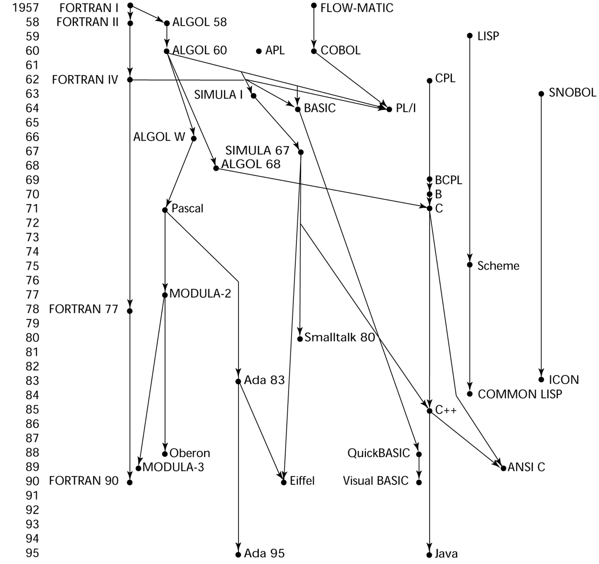
1-<number>

Slide 9

Fortran 0: 1954 - not implemented
Fortran I:1957
  Designed for the new IBM 704
  - This led to the idea of compiled programming languages, because there was no place to hide the cost of interpretation
  Environment of development
    Computers were small and unreliable
    Applications were scientific
    No programming methodology or tools
    Machine efficiency was the most important concern
1-<number>

Slide 10

First implemented version of Fortran
  Names could have up to six characters
  Post-test counting loop (DO)
  Formatted I/O
  User-defined subprograms
  Three-way selection statement (arithmetic IF)
  No data typing statements
1-<number>

Slide 11
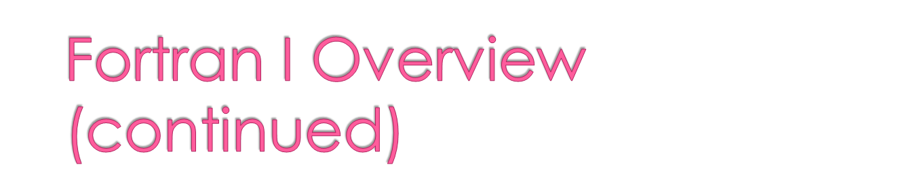
First implemented version of FORTRAN
  Programs larger than 400 lines rarely compiled correctly, mainly due to poor reliability of 704
  Code was very fast
  Quickly became widely used
1-<number>

Slide 12

Distributed in 1958
  Independent compilation
  Fixed the bugs
1-<number>

Slide 13

Evolved during 1960-62
  Explicit type declarations
  Logical selection statement
  Subprogram names could be parameters
  ANSI standard in 1966
1-<number>

Slide 14

Became the new standard in 1978
  Character string handling
  Logical loop control statement
  IF-THEN-ELSE statement
1-<number>

Slide 15

Most significant changes from Fortran 77
  Modules
  Dynamic arrays
  Pointers
  Recursion
  CASE statement
  Parameter type checking
1-<number>

Slide 16

Fortran 95 – relatively minor additions, plus some deletions
Fortran 2003 – support for OOP, procedure pointers, interoperability with C
Fortran 2008 – blocks for local scopes, co-arrays, Do Concurrent
1-<number>

Slide 17

Highly optimizing compilers (all versions before 90)
  Types and storage of all variables are fixed before run time
Dramatically changed forever the way computers are used
1-<number>

Slide 18
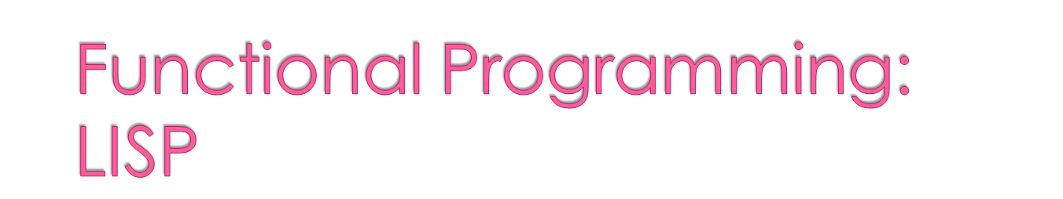
LISt Processing language
  Designed at MIT
Artificial Intelligence research needed a language to
  Process data in lists (rather than arrays)
  Symbolic computation (rather than numeric)
Only two data types: atoms and lists
1-<number>

Slide 19

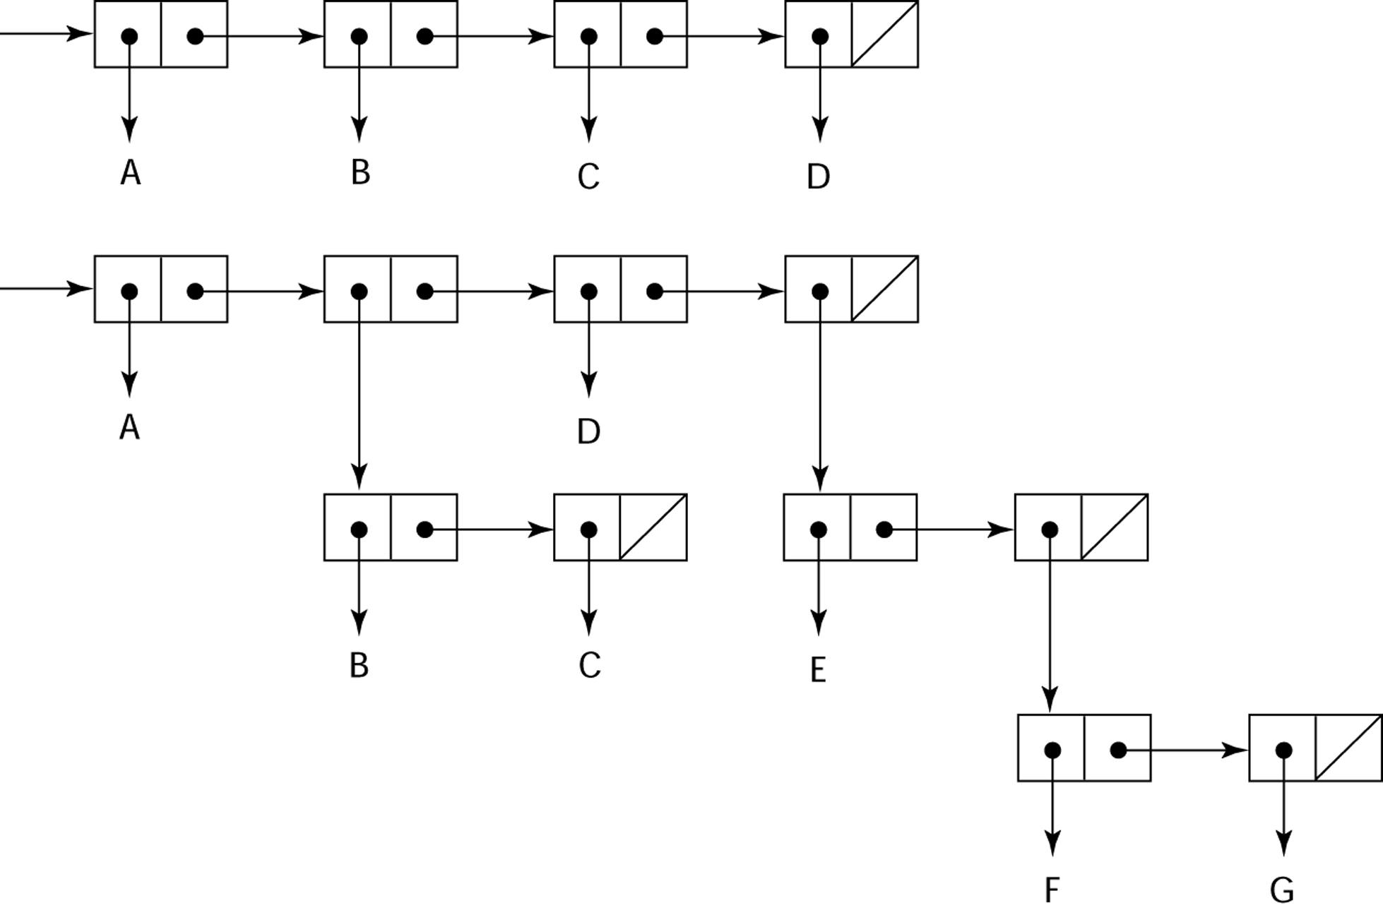
Representing the lists (A B C D)
and (A (B C) D (E (F G)))
1-<number>

Slide 20

Pioneered functional programming
  No need for variables or assignment
  Control via recursion and conditional expressions
Still the dominant language for AI
COMMON LISP and Scheme are contemporary dialects of LISP
ML, Haskell, and F# are also functional programming languages, but use very different syntax
1-<number>

Slide 21

Developed at MIT in mid 1970s
Small
Extensive use of static scoping
Functions as first-class entities
Simple syntax (and small size) make it ideal for educational applications
1-<number>

Slide 22

An effort to combine features of several dialects of LISP into a single language
Large, complex, used in industry for some large applications
1-<number>

Slide 23
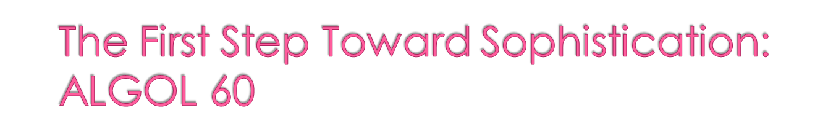
Environment of development
  FORTRAN had arrived for IBM 70x
  Many other languages were being developed, all for specific machines
  No portable language; all were machine- dependent
  No universal language for communicating algorithms
ALGOL 60 was the result of efforts to design a universal language
1-<number>

Slide 24

ACM and GAMM met for four days for design (May 27 to June 1, 1958)
Goals of the language
  Close to mathematical notation
  Good for describing algorithms
  Must be translatable to machine code
1-<number>

Slide 25

Concept of type was formalized
Names could be any length
Arrays could have any number of subscripts
Parameters were separated by mode (in & out)
Subscripts were placed in brackets
Compound statements (begin ... end)
Semicolon as a statement separator
Assignment operator was :=
if had an else-if clause
No I/O - “would make it machine dependent”
1-<number>

Slide 26

Modified ALGOL 58 at 6-day meeting in Paris
New features
  Block structure (local scope)
  Two parameter passing methods
  Subprogram recursion
  Stack-dynamic arrays
  Still no I/O and no string handling
1-<number>

Slide 27

Successes
  It was the standard way to publish algorithms for over 20 years
  All subsequent imperative languages are based on it
  First machine-independent language
  First language whose syntax was formally defined (BNF)
1-<number>

Slide 28
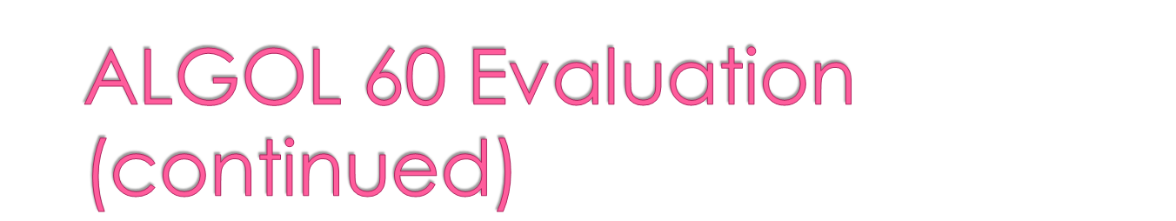
Failure
  Never widely used, especially in U.S.
  Reasons
    Lack of I/O and the character set made programs non-portable
    Too flexible--hard to implement
    Formal syntax description
    Lack of support from IBM
1-<number>

Slide 29
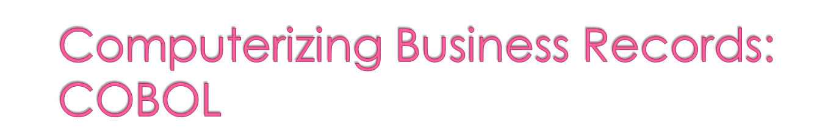
Based on FLOW-MATIC
FLOW-MATIC features
  Names up to 12 characters, with embedded hyphens
  English names for arithmetic operators (no arithmetic expressions)
  Data and code were completely separate
  The first word in every statement was a verb
1-<number>

Slide 30

First Design Meeting (Pentagon) - 1959
Design goals
  Must look like simple English
  Must be easy to use, even if that means it will be less powerful
  Must broaden the base of computer users
  Must not be biased by current compiler problems
Design committee members were all from computer manufacturers and DoD (Department of Defence)
Design Problems: arithmetic expressions? subscripts? Fights among manufacturers
1-<number>

Slide 31

Contributions
  First macro facility in a high-level language
  Hierarchical data structures (records)
  Nested selection statements
  Long names (up to 30 characters), with hyphens
  Separate data division
1-<number>

Slide 32

First language required by DoD
  would have failed without DoD
Still the most widely used business applications language
1-<number>

Slide 33

Designed by Kemeny & Kurtz at Dartmouth
Design Goals:
  Easy to learn and use for non-science students
  Must be “pleasant and friendly”
  Fast turnaround for homework
  Free and private access
  User time is more important than computer time
Current popular dialect: Visual BASIC
First widely used language
1-<number>

Slide 34

By 1963
  Scientific users began to need more elaborate I/O, like COBOL had; business users began to need floating point and arrays for MIS
The obvious solution
  Build a new computer to do both kinds of applications
  Design a new language to do both kinds of applications
1-<number>

Slide 35

Designed in five months by the 3 X 3 Committee
  Three members from IBM, three members from SHARE
Initial concept
  An extension of Fortran IV
Initially called NPL (New Programming Language)
Name changed to PL/I in 1965
1-<number>

Slide 36

PL/I contributions
  First exception handling
  Switch-selectable recursion
  First pointer data type
  First array cross sections
Concerns
  Many new features were poorly designed
  Too large and too complex
1-<number>

Slide 37
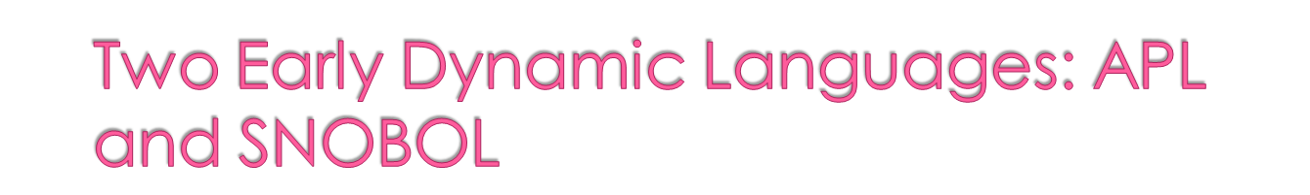
Characterized by dynamic typing and dynamic storage allocation
Variables are untyped
  A variable acquires a type when it is assigned a value
Storage is allocated to a variable when it is assigned a value
1-<number>

Slide 38

Designed as a hardware description language at IBM in 1960
  Highly expressive (many operators, for both scalars and arrays of various dimensions)
  Programs are very difficult to read
Still in use; minimal changes
1-<number>

Slide 39

Designed as a string manipulation language at Bell Labs in 1964
Powerful operators for string pattern matching
Slower than alternative languages (and thus no longer used for writing editors)
Still used for certain text processing tasks
1-<number>

Slide 40
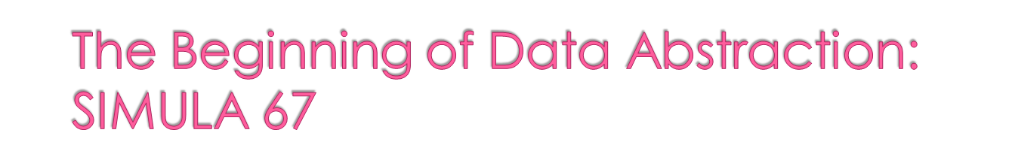
Designed primarily for system simulation in Norway by Nygaard and Dahl
Based on ALGOL 60 and SIMULA I
Primary Contributions
  Coroutines - a kind of subprogram
  Classes, objects, and inheritance
1-<number>

Slide 41
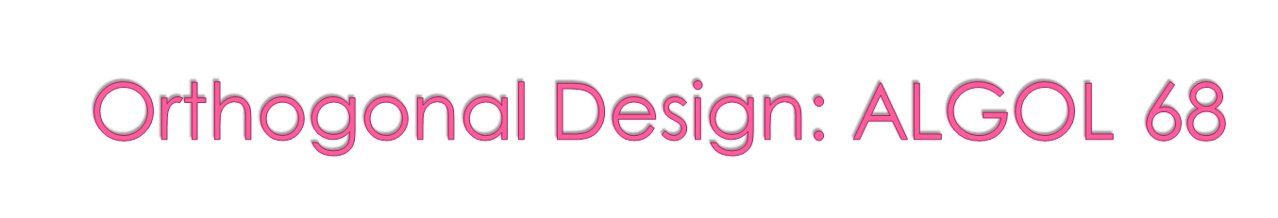
From the continued development of ALGOL 60 but not a superset of that language
Source of several new ideas (even though the language itself never achieved widespread use)
Design is based on the concept of orthogonality
  A few basic concepts, plus a few combining mechanisms
1-<number>

Slide 42

Contributions
  User-defined data structures
  Reference types
  Dynamic arrays (called flex arrays)
Comments
  Less usage than ALGOL 60
  Had strong influence on subsequent languages, especially Pascal, C, and Ada
1-<number>

Slide 43

Developed by Wirth (a former member of the ALGOL 68 committee)
Designed for teaching structured programming
Small, simple, nothing really new
Largest impact was on teaching programming
  From mid-1970s until the late 1990s, it was the most widely used language for teaching programming
1-<number>

Slide 44

Designed for systems programming at Bell Labs
Evolved primarily from BCLP and B, but also ALGOL 68
Powerful set of operators, but poor type checking
Initially spread through UNIX
Though designed as a systems language, it has been used in many application areas
1-<number>

Slide 45
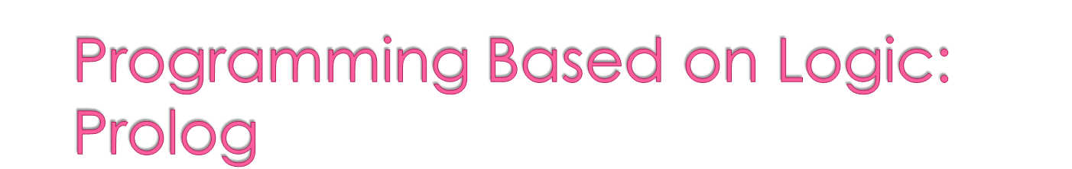
Developed, by Comerauer and Roussel (University of Aix-Marseille), with help from Kowalski ( University of Edinburgh)
Based on formal logic
Non-procedural
Can be summarized as being an intelligent database system that uses an inferencing process to infer the truth of given queries
Comparatively inefficient
Few application areas
1-<number>

Slide 46
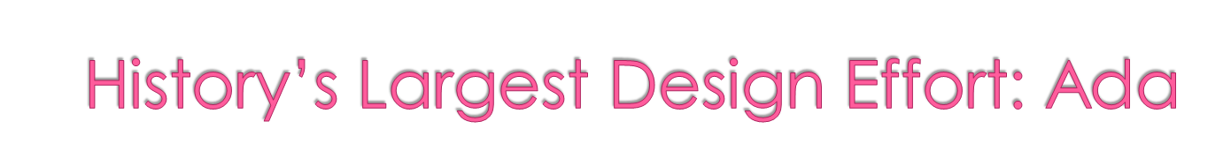
Huge design effort, involving hundreds of people, much money, and about eight years
Named Ada after Augusta Ada Byron, the first programmer
Contributions
  Packages - support for data abstraction
  Exception handling - elaborate
  Generic program units
1-<number>

Slide 47

Comments
  Competitive design
  Included all that was then known about software engineering and language design
  First compilers were very difficult; the first really usable compiler came nearly five years after the language design was completed
1-<number>

Slide 48

Ada 95 (began in 1988)
  Support for OOP through type derivation
  Better control mechanisms for shared data
  New concurrency features
  More flexible libraries
Ada 2005
  Interfaces and synchronizing interfaces
Popularity suffered because the DoD no longer requires its use but also because of popularity of C++
1-<number>

Slide 49

Developed at Xerox PARC
First full implementation of an object-oriented language (data abstraction, inheritance, and dynamic binding)
Pioneered the graphical user interface design
Promoted OOP
1-<number>

Slide 50
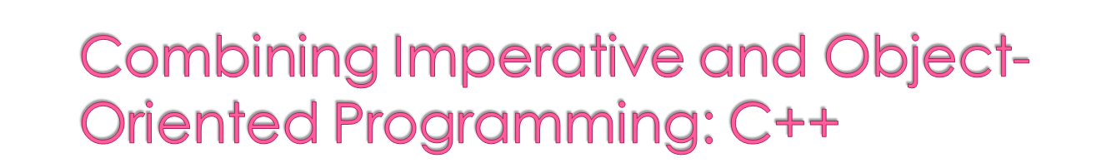
Developed at Bell Labs in 1980
Evolved from C and SIMULA 67
Facilities for object-oriented programming, taken partially from SIMULA 67
A large and complex language, in part because it supports both procedural and OO programming
Rapidly grew in popularity, along with OOP
ANSI standard approved in1997
1-<number>

Slide 51

Objective-C (designed by Brad Cox – early 1980s)
  C plus support for OOP based on Smalltalk
  Uses Smalltalk’s method calling syntax
  Used by Apple for systems programs
Delphi (Borland)
  Pascal plus features to support OOP
  More elegant and safer than C++
Go (designed at Google - 2009)
  Loosely based on C, but also quite different
  Does not support traditional OOP
1-<number>

Slide 52

Developed at Sun in the early 1990s
  C and C++ were not satisfactory for embedded electronic devices
Based on C++
  Significantly simplified (does not include struct, union, enum, pointer arithmetic, and half of the assignment coercions of C++)
  Supports only OOP
  Has references, but not pointers
  Includes support for applets and a form of concurrency
1-<number>

Slide 53

Eliminated many unsafe features of C++
Supports concurrency
Libraries for applets, GUIs, database access
Portable: Java Virtual Machine concept, JIT compilers
Widely used for Web programming
Use increased faster than any previous language
Most recent version, 7, released in 2011
1-<number>

Slide 54
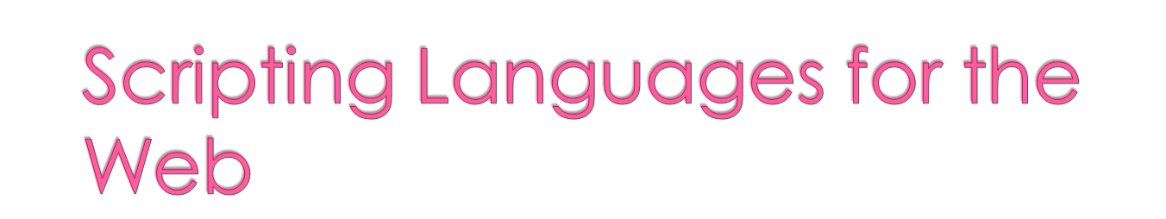
Perl
  Designed by Larry Wall—first released in 1987
  Variables are statically typed but implicitly declared
  Three distinctive namespaces, denoted by the first character of a
  variable’s name
  Gained widespread use for CGI programming on the Web
  Also used for a replacement for UNIX system administration language
1-<number>

Slide 55

JavaScript
  A joint venture of Netscape and Sun Microsystems
  A client-side HTML-embedded scripting language, often used to create dynamic HTML documents
  Purely interpreted
  Related to Java only through similar syntax
PHP
  Hypertext Preprocessor, designed by Rasmus Lerdorf
  A server-side HTML-embedded scripting language, often used for form processing and database access through the Web
  Purely interpreted
1-<number>

Slide 56
Python
  An OO interpreted scripting language
  Supports lists, tuples, and hashes
Ruby
  Designed in Japan by Yukihiro Matsumoto
  Began as a replacement for Perl and Python
  A pure object-oriented scripting language
  - All data are objects
  Most operators are implemented as methods, which can be redefined by user code
  Purely interpreted
1-<number>

Slide 57
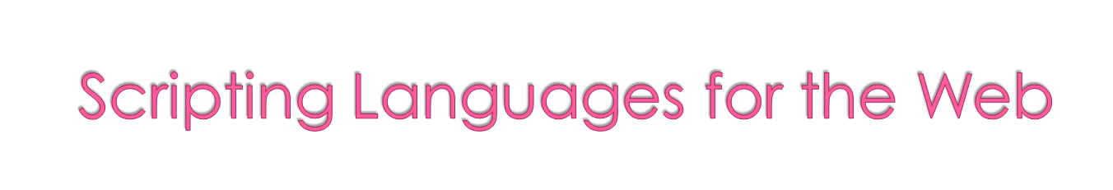
Lua
  An OO interpreted scripting language
  Type checked but dynamically typed
  Used for CGI programming and form processing
  Dynamically typed, but type checked
  Supports lists, tuples, and hashes, all with its single data structure,
  the table
  Easily extendable
1-<number>

Slide 58

Part of the .NET development platform (2000)
Based on C++ , Java, and Delphi
Includes pointers, delegates, properties, enumeration types, a limited kind of dynamic typing, and anonymous types
Is evolving rapidly
1-<number>

Slide 59

XSLT
  eXtensible Markup Language (XML): a metamarkup language
  eXtensible Stylesheet Language Transformation (XSTL) transforms XML documents for display
  Programming constructs (e.g., looping)
JSP
  Java Server Pages: a collection of technologies to support dynamic Web documents
  JSTL, a JSP library, includes programming constructs in the form of HTML elements
1-<number>

Slide 60

Continious development
Influences on each other
Some of them dies
Some lives until today
Marketing strategies important
Demand in market important
There is no good enough for all applications
1-<number>

